Slide 1
Morphology Optimization of a Tilt-Rotor MAV
Luca Rinsoz
MT
Supervised by Karen Bodie, Zachary Taylor and Prof. Dr. Roland Siegwart

Slide 2
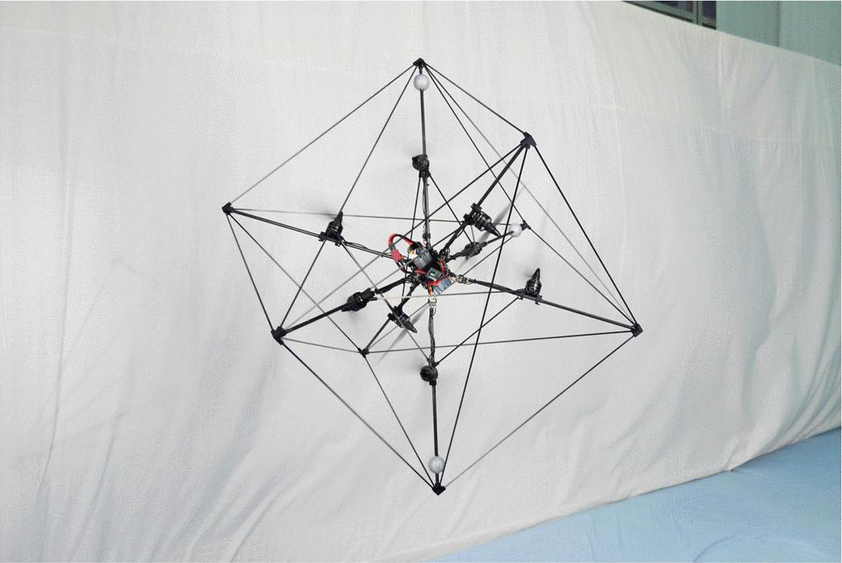
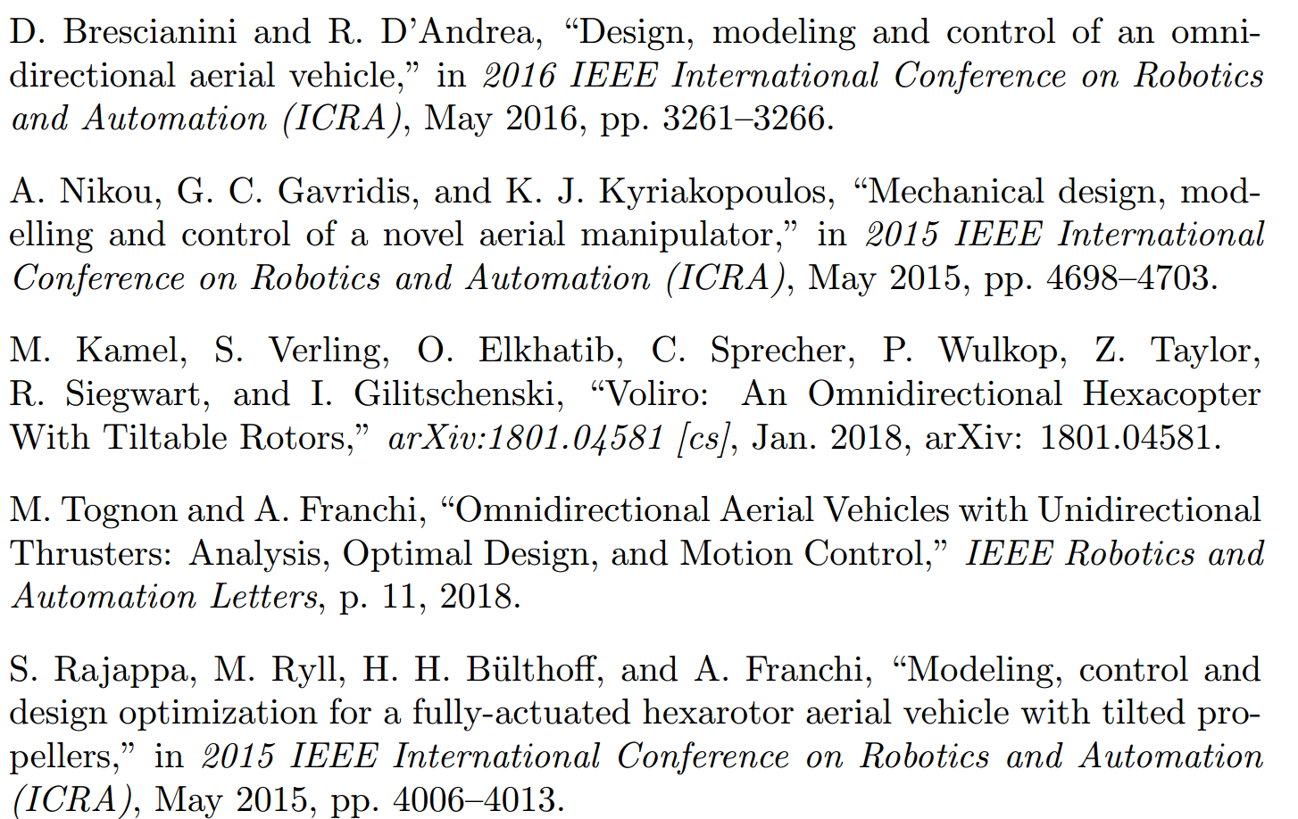
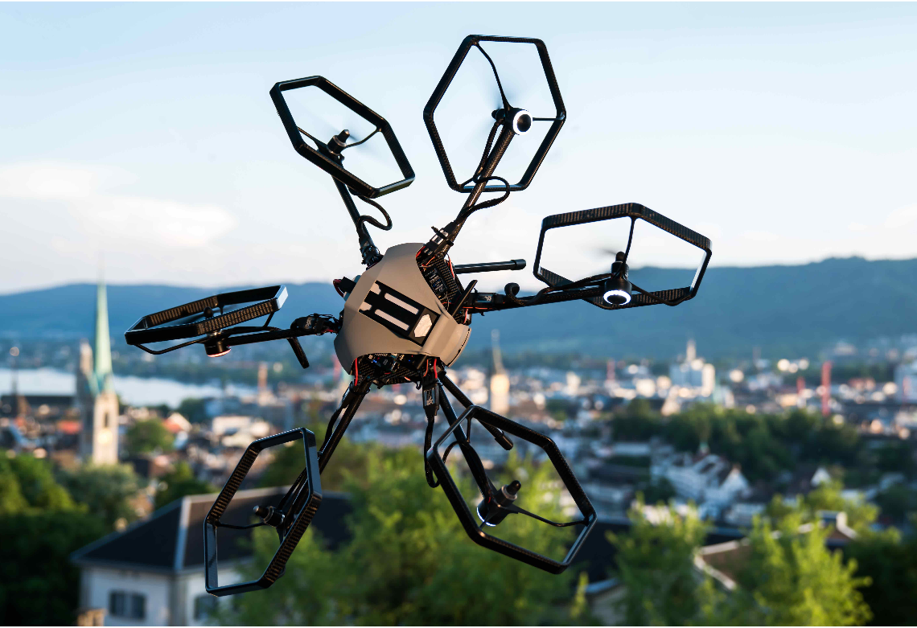
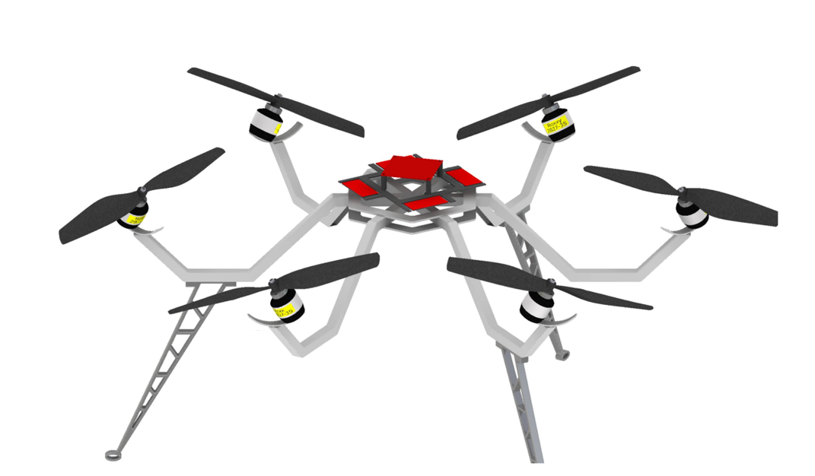
State of the art

Slide 3
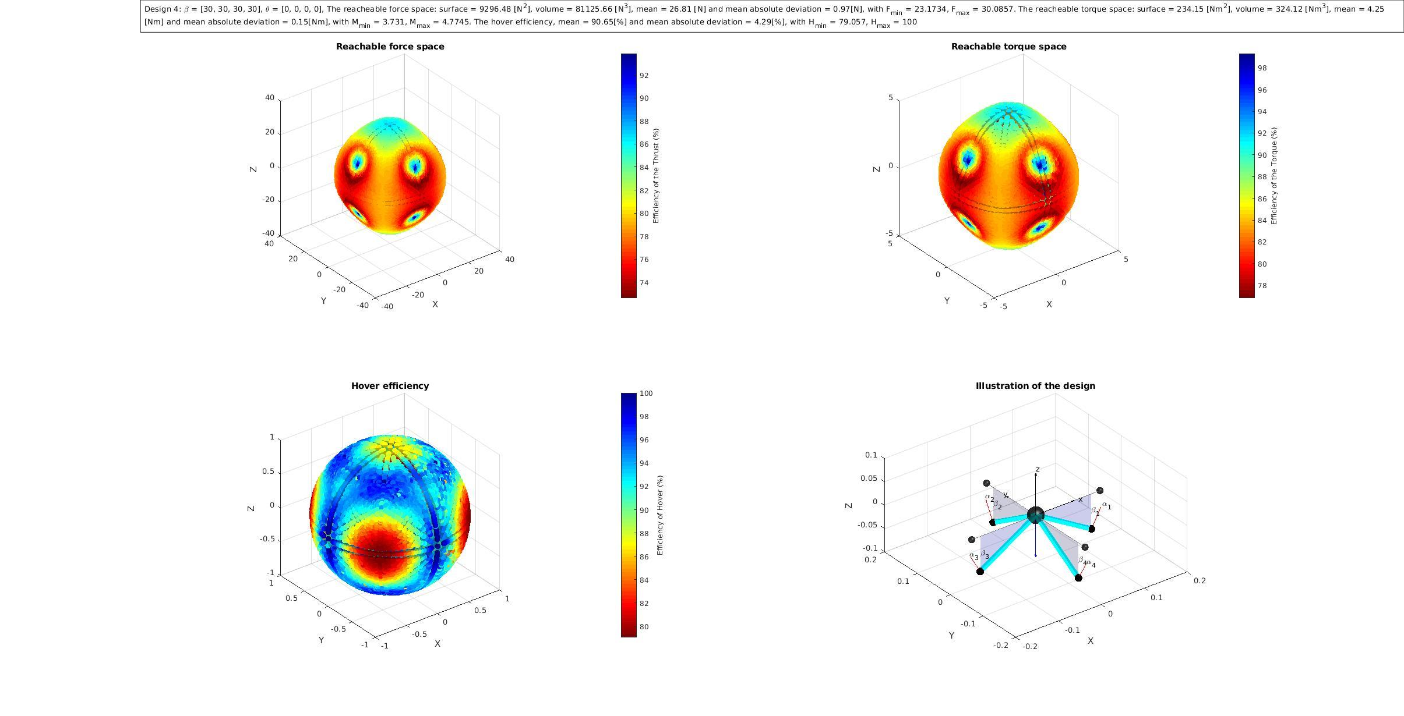
Realized
Matlab code for quadcopter based on fmincom

Slide 4
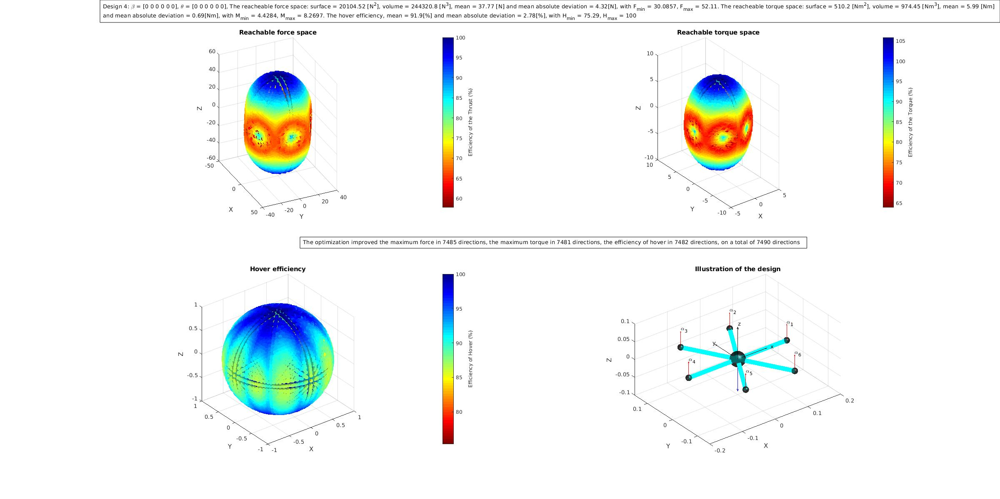
Realized
Matlab code for quadcopter based on fmincom
Generalized code for n-rotor MAV

Slide 5
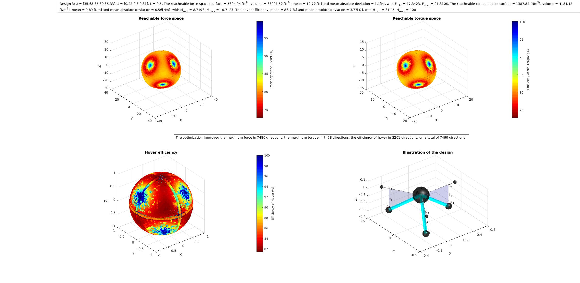
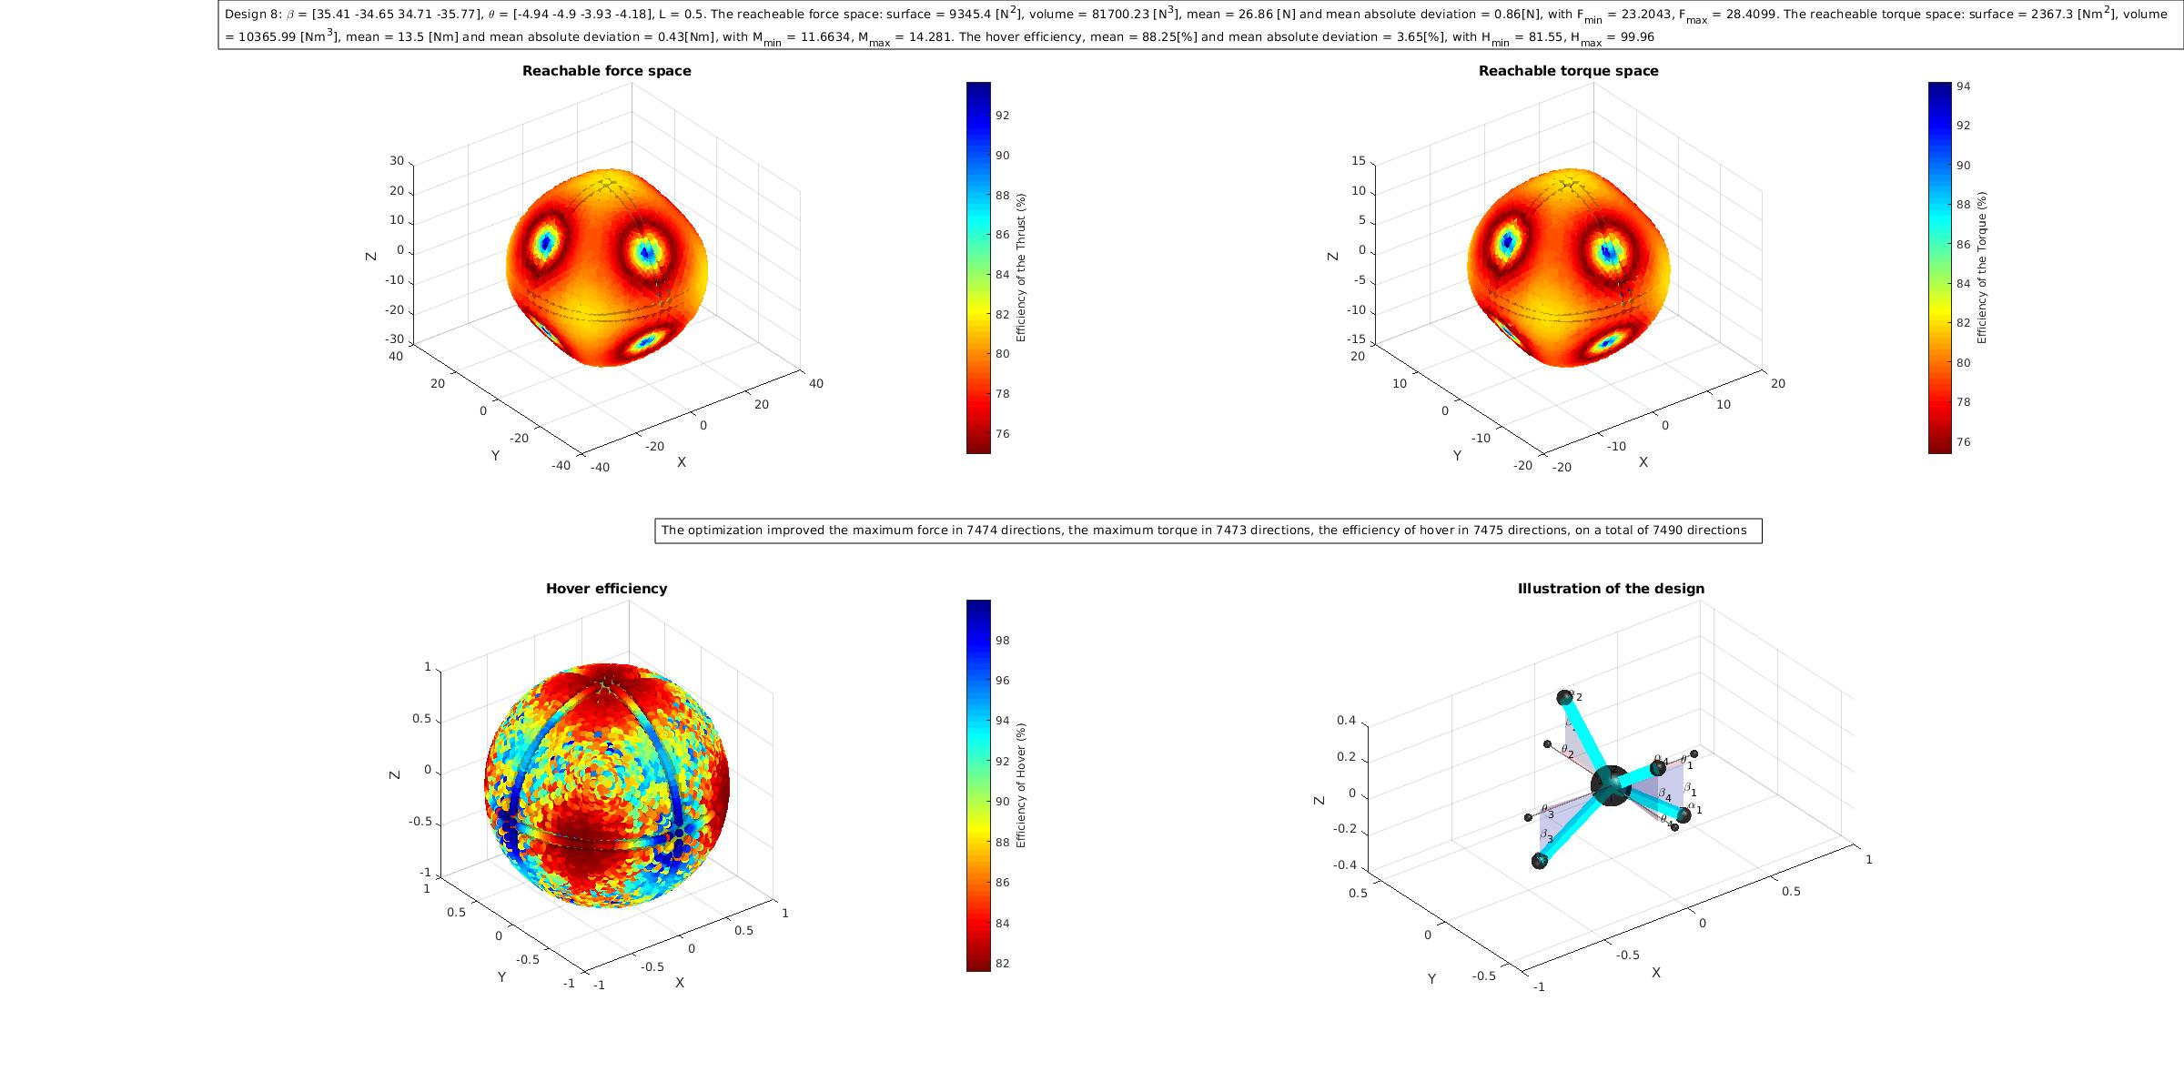
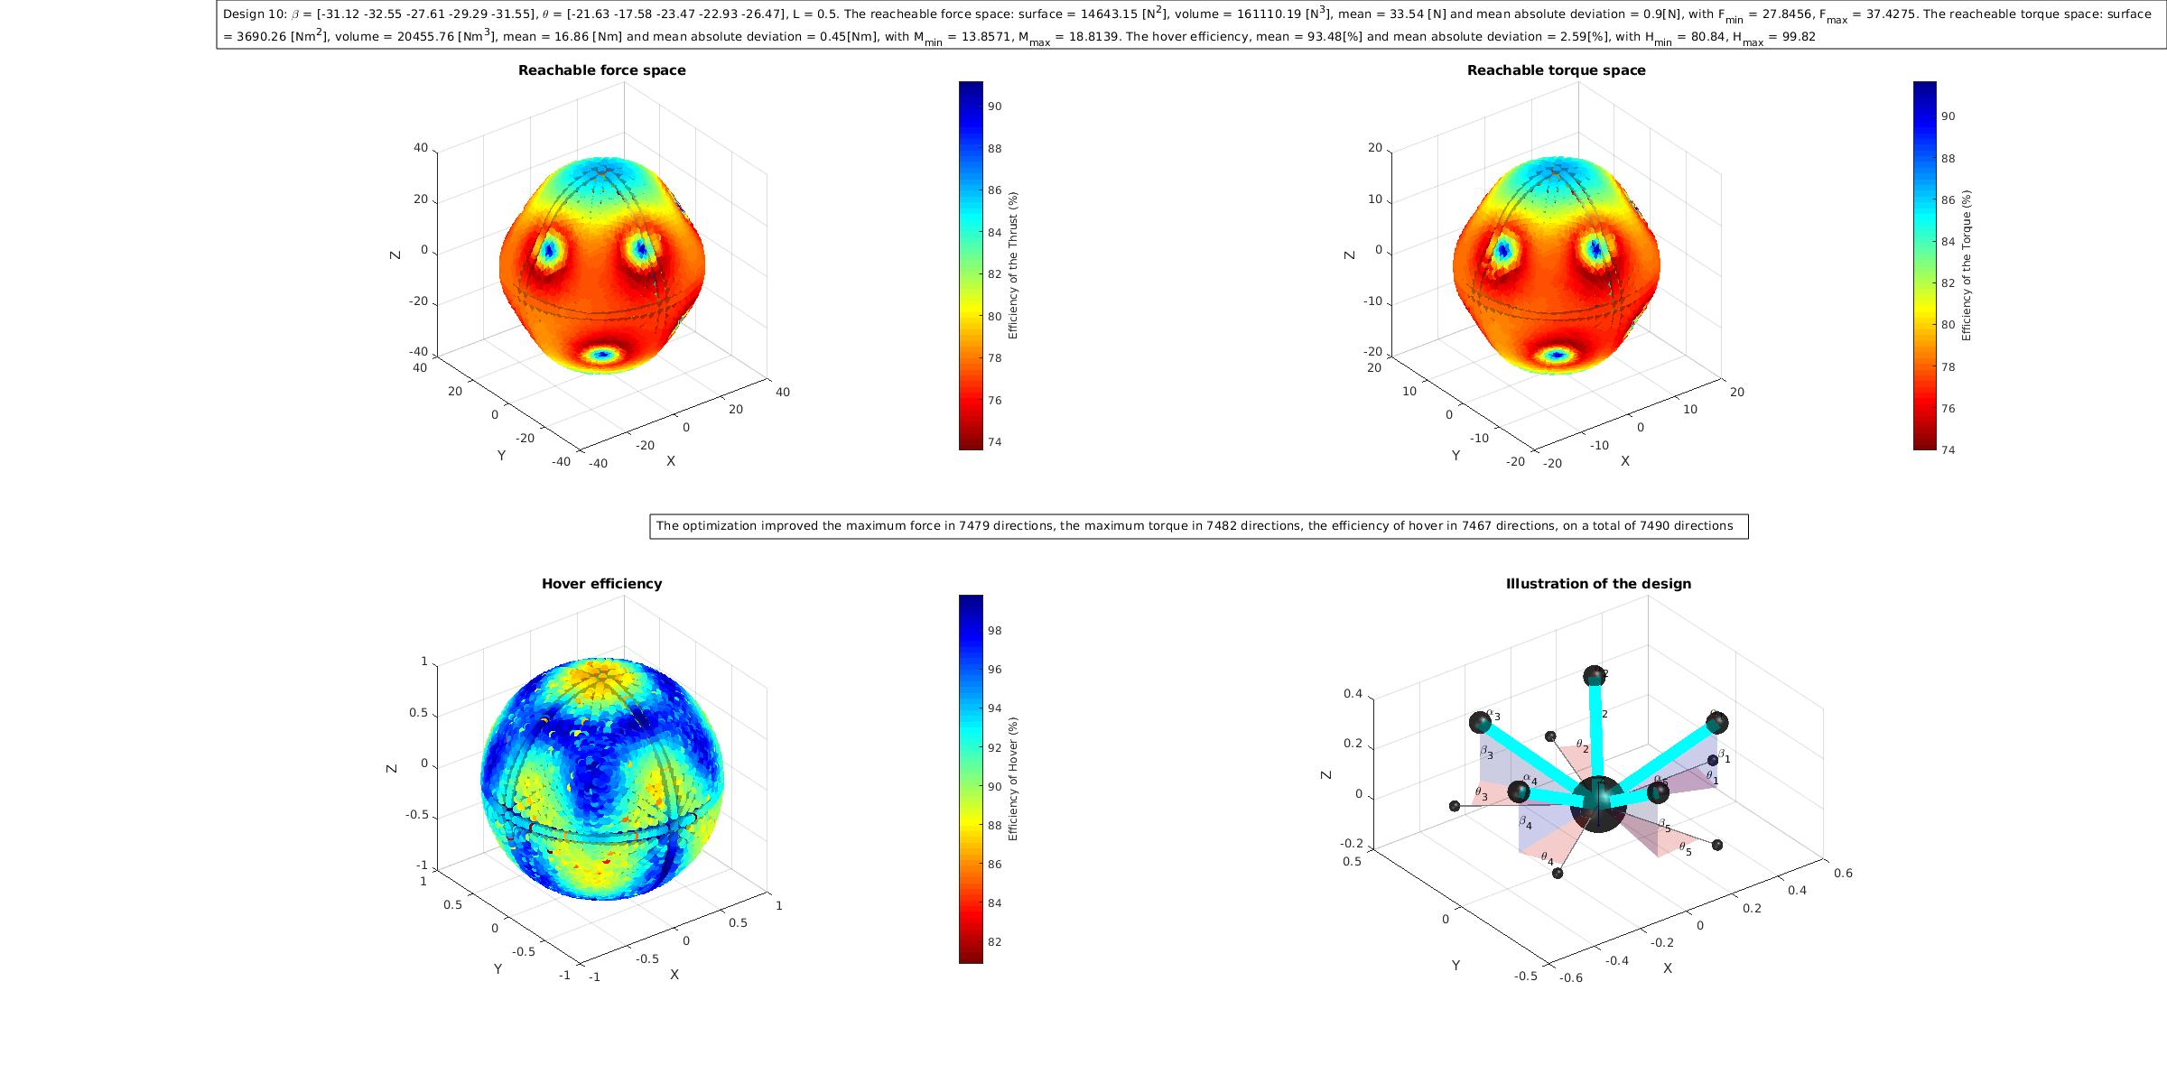
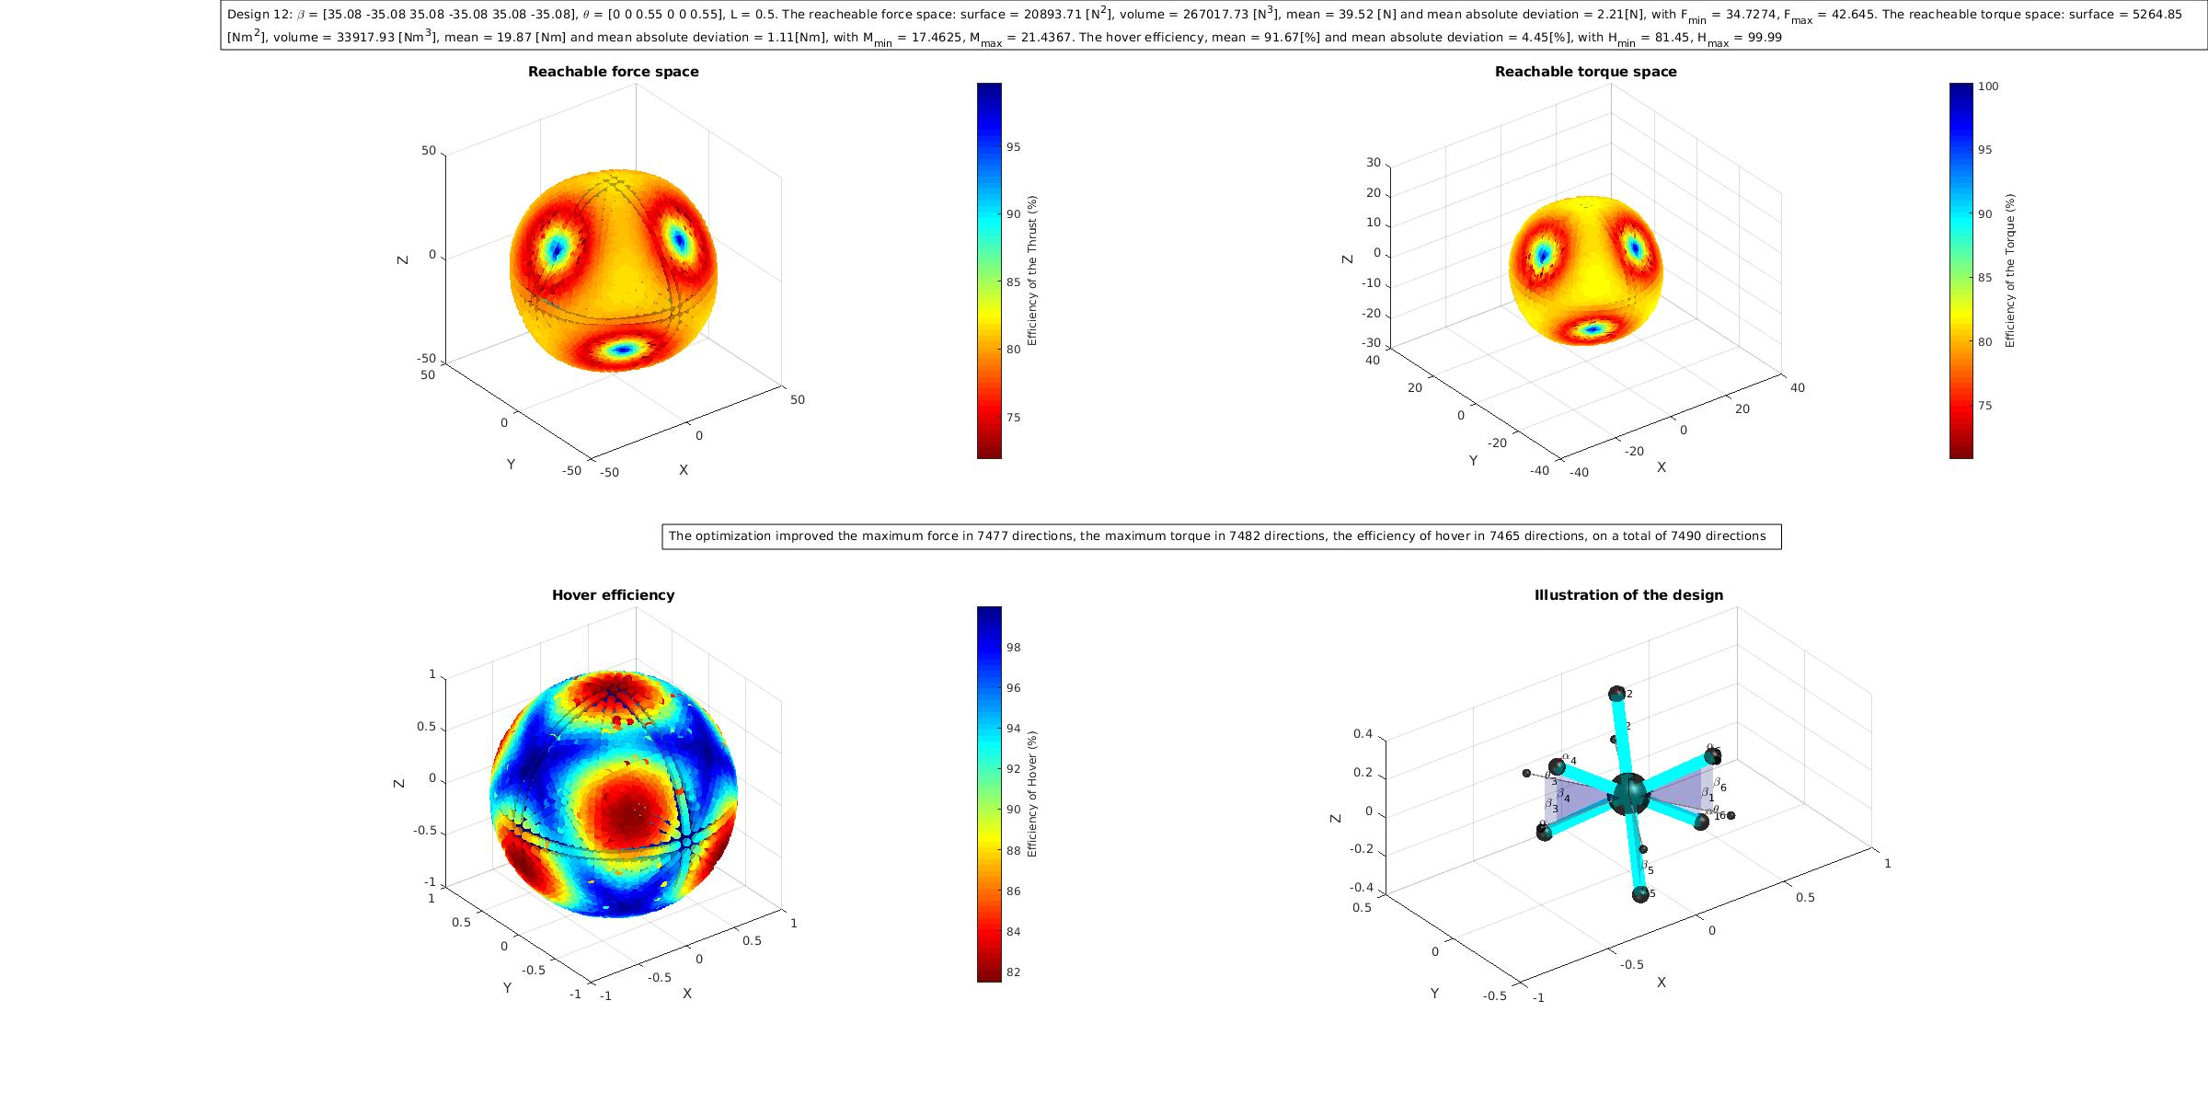
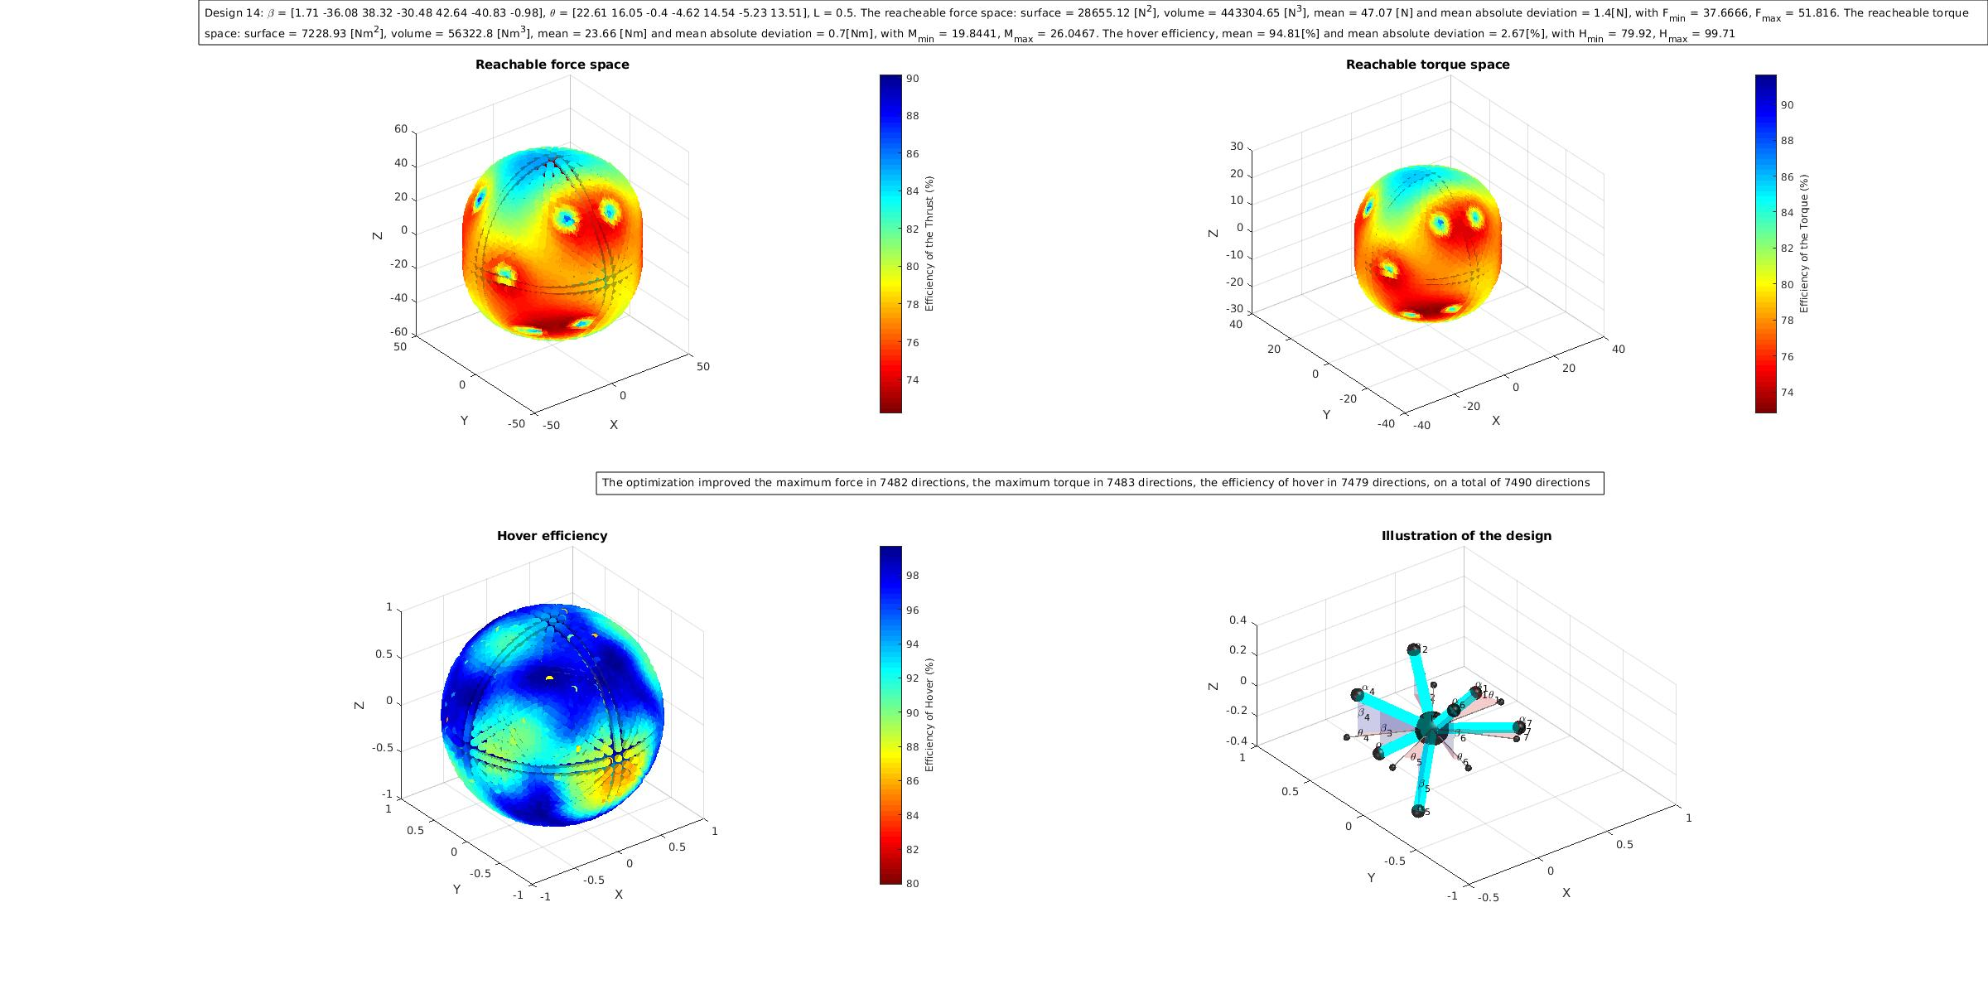
Realized
Matlab code for quadcopter based on fmincom
Generalized code for n-rotor MAV
Design optimization to find arms angles and lengh

Slide 6
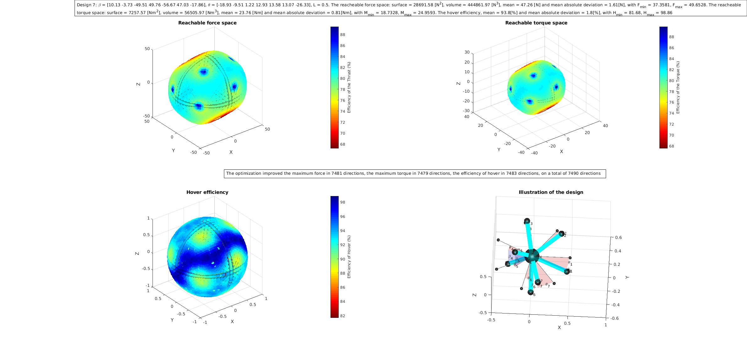
Realized
Matlab code for quadcopter based on fmincom
Generalized code for n-rotor MAV
Design optimization to find arms angles and lengh
Design optimization to find rotor numbers, arms angles and length

Slide 7
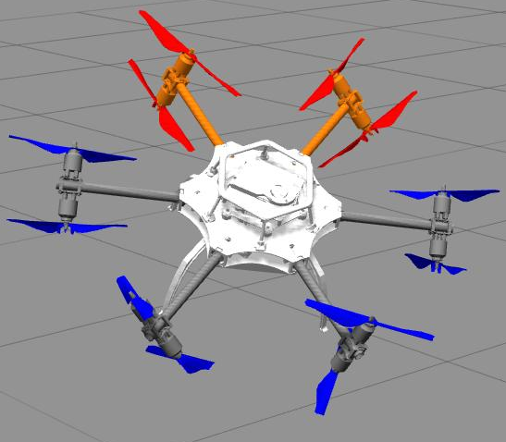
Further development
Find more meaningful cost functions
Obtain optimal design
Simulate design in ROS environment
Build a prototype

Slide 8
Questions ?
Thank you for your attention !

